Slide 1
UNIT IV:
Planning: Vision, Release Planning, The Planning Game,
Risk Management, Iteration Planning, Slack, Stories,Estimating.
Developing: Incremental requirements,
Customer Tests, Test-Driven Development,
Refactoring, Simple Design ,
Incremental Design and Architecture,
Spike Solutions, Performance Optimization,
Exploratory Testing

Slide 2
Agile Software Development

Slide 3
Planning
The larger your project becomes, the harder it is to plan everything in advance.
The more chaotic your environment, the more likely it is that your plans will be thrown off by some unexpected event.
Yet in this chaos lies opportunity.

Slide 4
The Agile approach to Planning
8 practices that allow you to control the chaos of endless possibility
Vision
Release Planning
The Planning Game
Risk Management
Iteration Planning
Slack
Stories
Estimating

Slide 5
The Agile approach to Planning
Vision
Reveals where the project is going and why it’s going there.
Release Planning
Provides a roadmap for reaching your destination.
The Planning Game
Combines the expertise of the whole team to create achievable plans.
Risk Management
Allows the team to make and meet long-term commitments.

Slide 6
The Agile approach to Planning
Iteration Planning
Provides structure to the team’s daily activities.
Slack
Allows the team to reliably deliver results every iteration.
Stories
Form the line items in the team’s plan.
Estimating
Enables the team to predict how long its work will take.

Slide 7
Vision
We know why our work is important and how we will be successful
Product Vision
Where Visions Come From
Identifying the Vision
Documenting the Vision
Promoting the Vision

Slide 8
Vision
Sometimes the vision for a project strikes as a single, compelling idea
One person gets a bright idea and gets approval to pursue it. This person is a visionary
More often, the vision isn’t so clear. There are multiple visionaries, each with their own unique idea of what the project should deliver
Either way, the project needs a single vision

Slide 9
Vision
Someone must unify, communicate, and promote the vision to the team and to stakeholders
That someone is the product manager

Slide 10
Vision
The vision statement
It is a clear and simple way of describing why the project deserves to exist.
It documents three things
What the project should accomplish
Why it is valuable
The project’s success criteria
It’s not a roadmap
That’s the purpose of release planning

Slide 11
Release Planning
Work out the details of how to achieve the vision
Create your own plans
Set your own release dates

Slide 12
Release Planning
One Project at a Time
Release Early, Release Often
How to Release Frequently
Adapt Your Plans
How to Create a Release Plan
Adaptive Planning and Organizational Culture

Slide 13
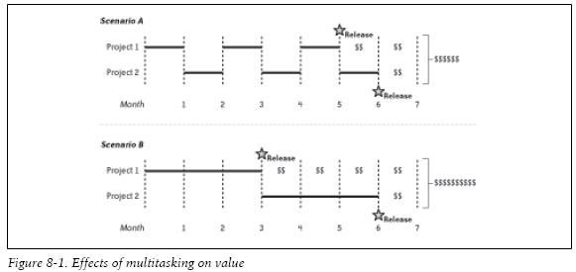
One Project at a Time

Slide 14
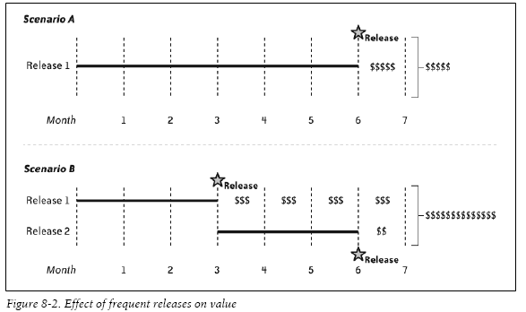
Release Early, Release Often

Slide 15
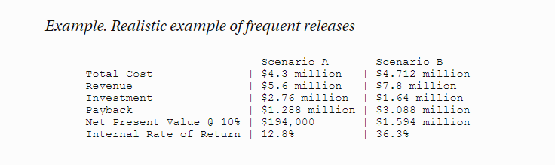

Slide 16
How to Release Frequently
Releasing frequently doesn’t mean setting aggressive deadlines.
In fact, aggressive deadlines extend schedules rather than reducing them.
Instead, release more often by including less in each release.
Minimum marketable features (MMF) are an excellent tool for doing so.
A minimum marketable feature, or MMF, is the smallest set of functionality that provides value to your market, whether that market is internal users (as with custom software) or external customers (as with commercial software).

Slide 17
Adapt Your Plans
If significant results are possible from frequent releases, imagine what you could accomplish if you could also increase the value of each release.
After each release
collect stakeholder feedback
cancel work on features that turned out to be unimportant
put more effort into those features that stakeholders find most valuable

Slide 18
How to Create a Release Plan
There are two basic types of plans
Scopeboxed
Timeboxed
Scopeboxed Plan
defines the features the team will build in advance, but the release date is uncertain.
Timeboxed plan
defines the release date in advance, but the specific features that release will include are uncertain.

Slide 19
Timeboxed plan
Timeboxed plans are almost always better
They constrain the amount of work you can do
Force people to make difficult but important prioritization decisions.
This requires the team to identify cheaper, more valuable alternatives to some requests.
Without a timebox, your plan will include more low-value features

Slide 20
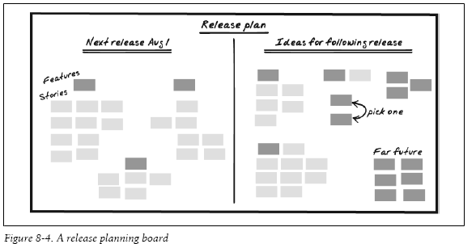

Slide 21
Adaptive Planning
It takes a lot of time and effort to brainstorm stories, estimate them, and prioritize them
If you’re adapting your plan as you go, some of that effort will be wasted
To reduce waste, plan at the last responsible moment
Your planning horizon determines how far you look into the future

Slide 22
Planning – Starting points
Your planning horizon determines how far you look into the future
Define the vision for the entire project
Define the release date for the next two releases
Define the minimum marketable features for the current release, and start to place features that won’t fit in this release into the next release
Define all the stories for the current feature and most of the current release. Place stories that don’t fit into the next release.
Estimate and prioritize stories for the current iteration and the following three iterations
Determine detailed requirements and customer tests for the stories in the current iteration

Slide 23
Organizational Culture
Work within your organization’s culture
No aspect of agile development challenges organizational culture more than the transition to adaptive planning.
It requires changes not only to the development team, but to reporting, evaluation, and executive oversight
You can work within your organization’s culture to do adaptive planning under the radar.
Use adaptive planning, but set your planning horizons to match the organization’s expectations

Slide 24
The Planning Game
Our plans take advantage of both business and technology expertise.
You may know when and what to release, but how do you actually construct your release plan?
That’s where the planning game comes in.

Slide 25
The Planning Game
In economics,
a game is something in which “players select actions and the payoffs depend on the actions of all players.”
The study of these games “deals with strategies for maximizing gains and minimizing losses
That describes the planning game perfectly.
It’s a structured approach to creating the best possible plan given the information available.
The planning game is most notable for the way it maximizes the amount of information contributed to the plan.

Slide 26
How to Play
XP assumes that customers have the most information about value
what best serves the organization.
Programmers have the most information about costs:
what it will take to implement and maintain those features.
To be successful, the team needs to
maximize value while minimizing costs.
A successful plan needs to take into account information from both groups.

Slide 27
How to Play - Contd
The planning game requires the participation of both customers and programmers.
It’s a cooperative game
the team as a whole wins or loses, not individual players.
Programmers have the most information about costs
Programmers estimate: most qualified to say how long it will take to implement a story
Customers have the most information about value
Customers prioritize: most qualified to say what is important

Slide 28
How to Play - Contd
Both groups (programmers & customers) come together, each with their areas of expertise, and play the planning game:
Anyone creates a story or selects an unplanned story.
Programmers estimate the story.
Customers place the story into the plan in order of its relative priority.
The steps are repeated until all stories have been estimated and placed into the plan.
The result of the planning game is a plan: a single list of stories in priority order

Slide 29
The Planning Game - Results
When you play the planning game well
Both customers and programmers feel that they have contributed to the plan.

Slide 30
Risk Management
Stakeholders need schedule commitments that they can rely upon.
Risk management allows you to make and meet these commitments.

Slide 31
A Generic Risk Management Plan
Every project faces a set of common risks
Turnover, New requirements, Work disruption, and so forth.
These risks act as a multiplier on your estimates, doubling or tripling the amount of time it takes to finish your work.

Slide 32
A Generic Risk Management Plan
Generic Risk Multipliers
Process approach
Percent chance | Rigorous | Risky | Description
10% | x 1 | x 1 | Almost impossible (“ignore”)
50% | x 1.4 | x 2 | 50-50 chance (“stretch goal”)
90% | x 1.8 | x 4 | Virtually certain (“commit”)
These multipliers show your chances of meeting various schedules

Slide 33
A Generic Risk Management Plan - contd
In a “Risky” approach,
You have a 10 percent chance of finishing according to your estimated schedule.
Doubling your estimates gives you a 50 percent chance of on-time completion, and
To be virtually certain of meeting your schedule, you haveto quadruple your estimates

Slide 34
A Generic Risk Management Plan - contd
If you use the XP practices - in particular
If you’re strict about being “done done” every iteration
Your velocity is stable, and
You fix all your bugs each iteration,
Then your risk is lowered
Use the risk multiplier in the “Rigorous” column.
On the other hand,
If you’re not strict about being “done done” every iteration
If your velocity is unstable, or
If you postpone bugs and other work for future iterations
Then - use the risk multiplier in the “Risky” column

Slide 35
Project-Specific Risks
Create a risk census
A list of the risks your project faces that focuses on your project’s unique risks.
What about the project keeps you up at night?
Imagine it’s a year after the project’s disastrous failure and you’re being interviewed about what went wrong. What happened?
Imagine your best dreams for the project, then write down the opposite.
How could the project fail without anyone being at fault?
How could the project fail if it were the stakeholders’ faults? The customers’ faults? Testers? Programmers? Management? Your fault? Etc.
How could the project succeed but leave one specific stakeholder unsatisfied or angry?

Slide 36
Project-Specific Risks – Contd.
Once you have your list of catastrophes, brainstorm scenarios that could lead to those catastrophes.
From those scenarios, imagine possible root causes.
These root causes are your risks: the causes of scenarios that will lead to catastrophic results.

Slide 37
Project-Specific Risks – Contd.
For the risks you decide to handle, determine
Transition Indicators
Mitigation Activities
Contingency Activities
Risk Exposure

Slide 38
Project-Specific Risks – Contd.
Transition Indicators
Tell you when the risk will come true
Mitigation Activities
Reduce the impact of the risk
Mitigation happens in advance, regardless of whether the risk comes to pass.
Contingency Activities
Also reduce the impact of the risk, but they are only necessary if the risk occurs.
Risk Exposure
Reflects how much time or money you should set aside to contain the risk.

Slide 39
Iteration Planning
Iterations are the heartbeat of an XP project.
When an iteration starts, stories flow in to the team as they select the most valuable stories from the release plan.
Over the course of the iteration, the team breathes those stories to life.
By the end of the iteration, they’ve pumped out working, tested software for each story and are ready to begin the cycle again.

Slide 40
The Iteration Timebox
Iterations allow you to avoid surprises.
Iterations are exactly one week long and have a strictly defined completion time.
This is a timebox: work ends at a particular time regardless of how much you’ve finished.
Although the iteration timebox doesn’t prevent problems, it reveals them, which gives you the opportunity to correct the situation.
In XP, the iteration demo marks the end of the iteration.

Slide 41
The Iteration Schedule
Iterations follow a consistent, unchanging schedule:
Demonstrate previous iteration (up to half an hour)
Hold retrospective on previous iteration (one hour)
Plan iteration (half an hour to four hours)
Commit to delivering stories (five minutes)
Develop stories (remainder of iteration)
Prepare release (less than 10 minutes)
Choose an iteration start time that works for your team, and stick with it.

Slide 42
Planning an Iteration
After the iteration demo and retrospective are complete, iteration planning begins.
Start by measuring the velocity of the previous iteration.
Take all the stories that are “done done” and add up their original estimates.
This number is the amount of story points you can reasonably expect to complete in the upcoming iteration

Slide 43
Terminologies
Your velocity is the number of story points you can complete in an iteration.
Story points are the ideal engineering days
Number of days a task would take if you focused on it entirely and experienced no interruptions.

Slide 44
Estimation
Tips for Accurate Estimates
You can have accurate estimates if you
Estimate in terms of ideal engineering days (story points), not calendar time
Use velocity to determine how many story points the team can finish in an iteration
Use iteration slack to smooth over surprises and deliver on time every iteration
Use risk management to adjust for risks to the overall release plan

